Slide 1
DATA ANALYTICS End-To-End PROJECT
ShopNova E-Commerce
Analytics
End-to-end sales, customer, product & returns analysis using SQL, Excel, Tableau & Power BI
SQL
EXCEL
TABLEAU
POWER BI
Group Presentation - 6

Slide 2
AGENDA
What We'll Cover Today
01
Project Overview
05
Tableau Dashboards
Business context, objective & scope of the ShopNova analysis
Interactive marketing & campaign performance views
02
Data & Tools
06
Power BI
5 linked datasets and the analytics stack used end-to-end
Interactive KPI’s, visualizations, filters and Dashboards
03
SQL Analysis
07
Key Insights
Query-driven exploration across revenue, orders & customers
What the data tells us — and what we recommend
04
Excel Dashboards
Executive, Customer, Product & Returns dashboards
ShopNova E-Commerce Analytics
2

Slide 3



PROJECT OVERVIEW
Turning ShopNova's Raw Order Data
into Business Decisions
ShopNova is an end-to-end e-commerce sales analytics project developed using Excel, SQL, Tableau, and Power BI to analyse sales performance, customer behavior, product performance, marketing campaigns, and returns. The project covers 7,562 orders, 800 customers, 87 SKUs, and 108 marketing campaigns across January–December 2023, with interactive dashboards created to identify key trends and generate actionable business insights.
PROJECT SCOPE
7,562
Orders analysed
800
Objective
Registered customers
Analyse e-commerce data to identify sales trends, customer behavior, and key business performance drivers.
87
Approach
Products Available
Clean, transform, and analyze data using Excel, SQL, Tableau, and Power BI to create interactive dashboards and KPIs.
108
Marketing campaigns
Outcome
Jan – Dec 2023
Generated actionable insights to improve sales performance, customer engagement, product strategy, and marketing effectiveness.
Full-year coverage
ShopNova E-Commerce Analytics
3

Slide 4



DATA & TOOLS
Five Linked Datasets, One Analytics Stack
Orders
Customers
Products
Campaigns
Returns
7,562 rows
800 rows
87 rows
108 rows
574 rows
Line-level transactions: pricing, discount, GST, status, channel
Demographics, segment, acquisition channel, lifetime value
Category, brand, cost & selling price, rating, stock
Monthly spend, clicks, conversions, ROAS by channel
Return reason, refund amount, resolution time, feedback
Structured e-commerce data across Orders, Customers, Products, and Marketing Campaigns, connected through common keys to create an integrated analytical data model.
ANALYTICS STACK
MySQL
Excel
Tableau
Power BI
Data cleaning, validation
& KPI query logic
Pivot-driven KPI &
dashboard modelling
Interactive marketing &
campaign visuals
Interactive KPI’s, Visualizations and Dashboard
ShopNova E-Commerce Analytics
4

Slide 5
SQL ANALYSIS
Seven Query Modules Behind the Numbers
All KPIs used across the Excel and Tableau dashboards trace back to a validated MySQL database (ShopNovaDB) built from the five source tables.
1. Data Setup & Validation
5. Customer Analysis
Row-count checks, duplicate-ID detection across all 5 tables
Segment value, acquisition channel, geography, CLV
2. Overall Analysis
6. Product Analysis
Headline KPIs — revenue, orders, customers, ROAS in one view
Category revenue, margin %, stock health, top brands
3. Revenue Analysis
7. Campaigns & Returns
Gross vs. net revenue, discounts, GST, AOV, GMV
Return reasons, refund status, campaign spend vs. revenue
4. Orders Analysis
Status mix, cancellation & return rate, channel & category split
select customer_segment, concat(round(avg(total_spend_lifetime_inr)/1000,2),' K') as average_clv
from customers group by customer_segment order by avg(total_spend_lifetime_inr) desc;
ShopNova E-Commerce Analytics
5

Slide 6
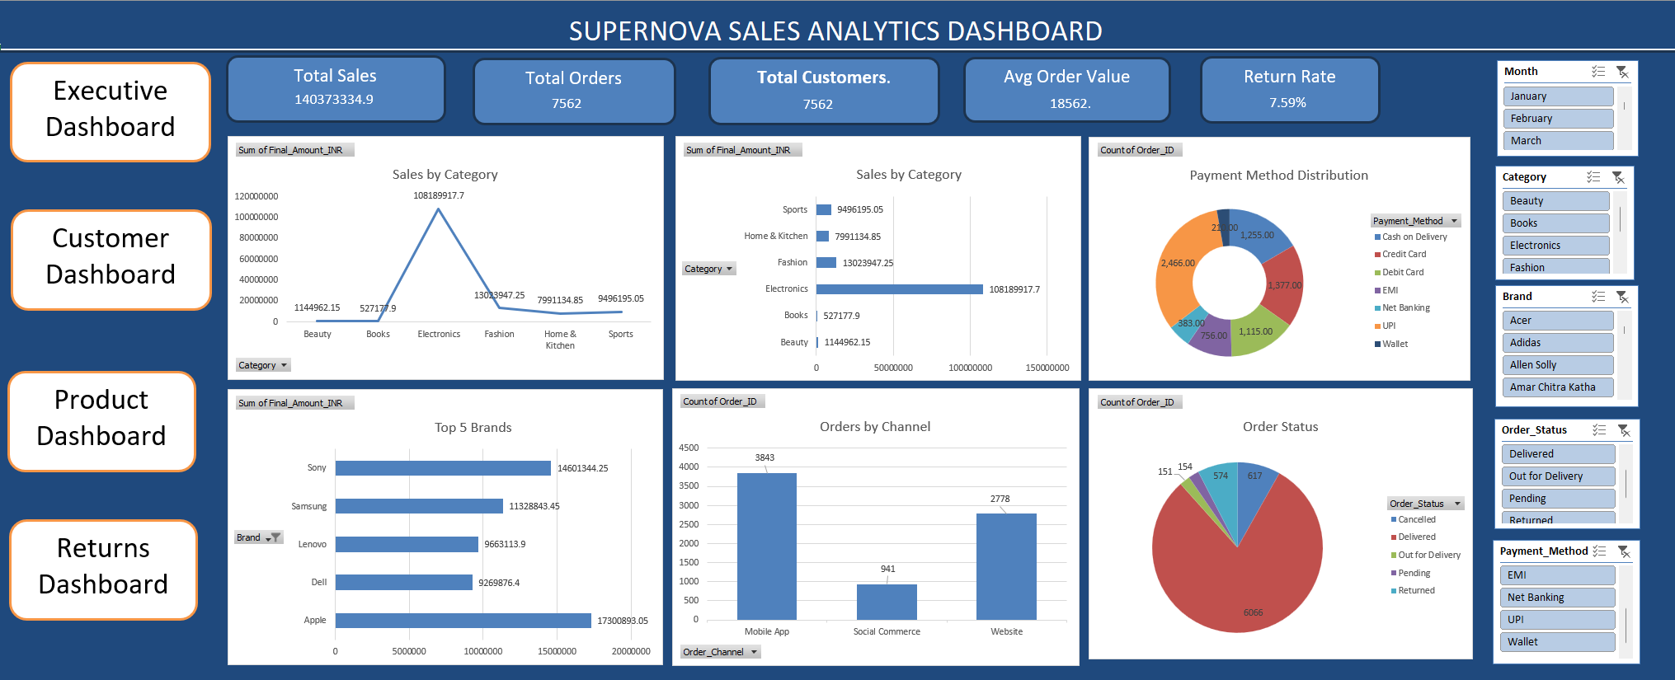
EXCEL DASHBOARD · 01
Executive Overview
KEY TAKEAWAYS
₹140.37M in total revenue across 7,562 orders (AOV ≈ ₹18,563)
Electronics drives ₹108.19M — over 75% of total sales
Sony, Apple & Samsung are the top 3 revenue brands
Website & Mobile App together generate ~87% of orders
80% of orders reach ‘Delivered’ status
ShopNova E-Commerce Analytics
6

Slide 7
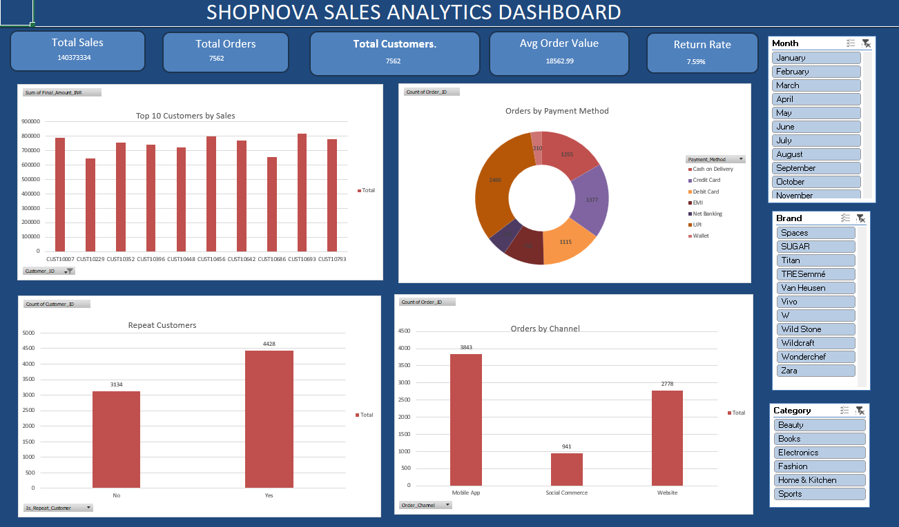
EXCEL DASHBOARD · 02
Customer Analysis
KEY TAKEAWAYS
4,428 repeat orders vs. 3,134 first-time — loyalty is a strong revenue lever
Credit Card & UPI lead the payment mix, together ~55% of orders
Mobile App (3,843 orders) outpaces Website (2,778) and Social Commerce
Top 10 customers each contribute ₹6–8 lakh in lifetime sales
Segments range from New to VIP, with VIP customers spending far above average
ShopNova E-Commerce Analytics
7

Slide 8
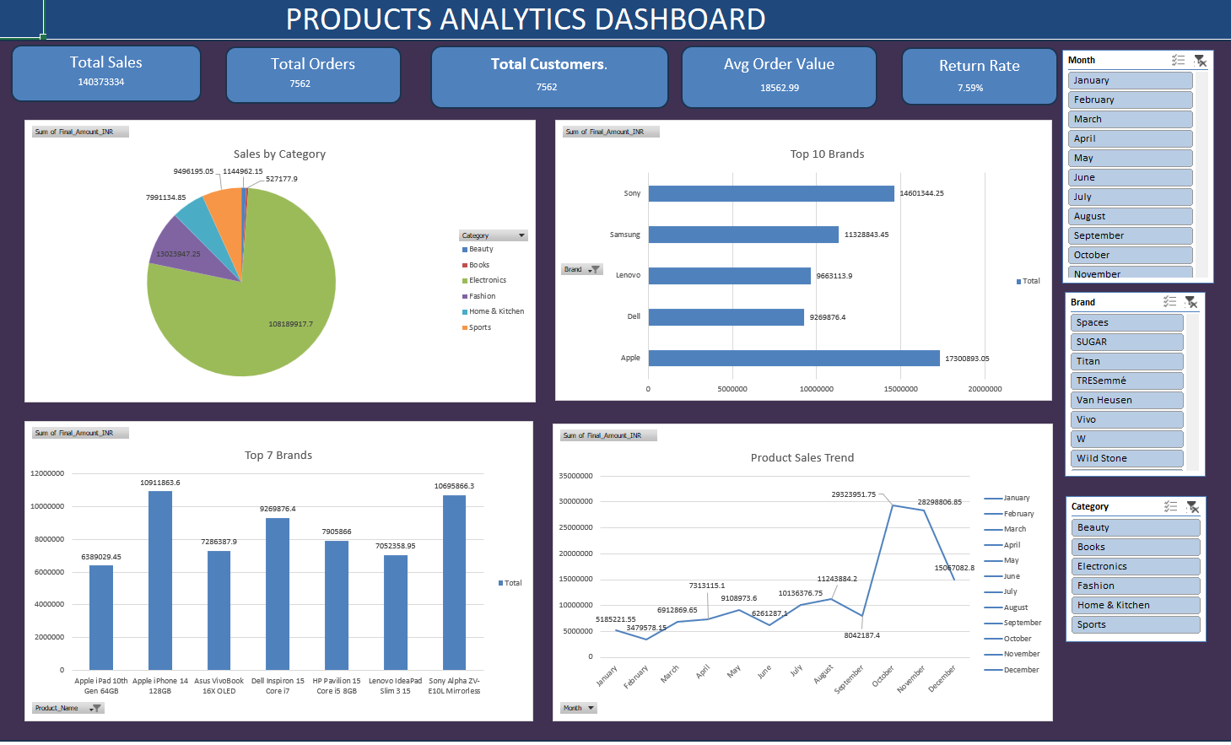
EXCEL DASHBOARD · 03
Product Analysis
KEY TAKEAWAYS
Electronics dominates the category mix at ₹108.19M of ₹140M total sales
Sony (₹14.6M) and Apple (₹17.3M) are the highest-selling brands
iPhone 14 128GB and Sony Alpha ZV-E10 are standout individual SKUs
Sales trend spikes sharply in Oct–Nov, pointing to a festive/sale-season effect
87 active SKUs across 6 categories keep the catalogue tightly curated
ShopNova E-Commerce Analytics
8

Slide 9
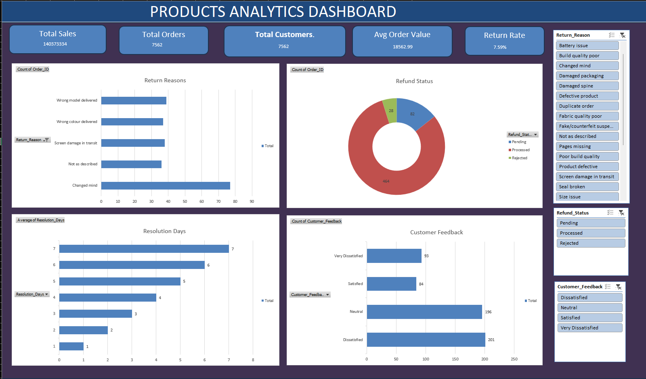
EXCEL DASHBOARD · 04
Returns & Service Quality
KEY TAKEAWAYS
574 returns overall — a manageable 7.59% return rate
‘Changed mind’ is the single largest return reason, ahead of damage or mismatch issues
81% of returns are refunded (‘Processed’); very few are rejected
Resolution takes up to 7 days, with most cases closing within the first few days
Feedback skews Neutral/Dissatisfied — the returns experience is an improvement area
ShopNova E-Commerce Analytics
9

Slide 10

TABLEAU DASHBOARD
Interactive Marketing & Campaign View
Built in Tableau from the same relational model, this workbook adds interactivity — filters, drill-downs and cross-highlighting — across two linked dashboards focused on marketing efficiency and campaign ROI.
Dashboard 1 — Sales and Operations Dashboard
Dashboard 2 — Customer and Marketing dashboard
Sales and Order Performance
Customer acquisition and segments
Product and Category Performance
Acquisition channel mix over time
Order Status and customer analysis
Marketing campaign performance
Fields tracked include sales, orders, customers, products, campaign performance and customer acquisition metrics across 108 campaign records.
ShopNova E-Commerce Analytics
10

Slide 11
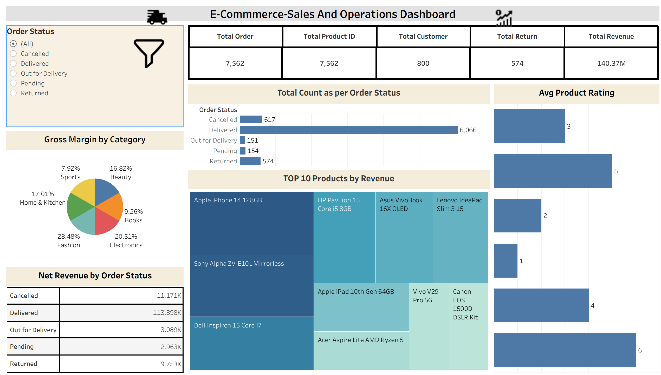
Tableau Dashboards
Dashboard 1 — Sales and Operation Dashboard
ShopNova E-Commerce Analytics
11

Slide 12
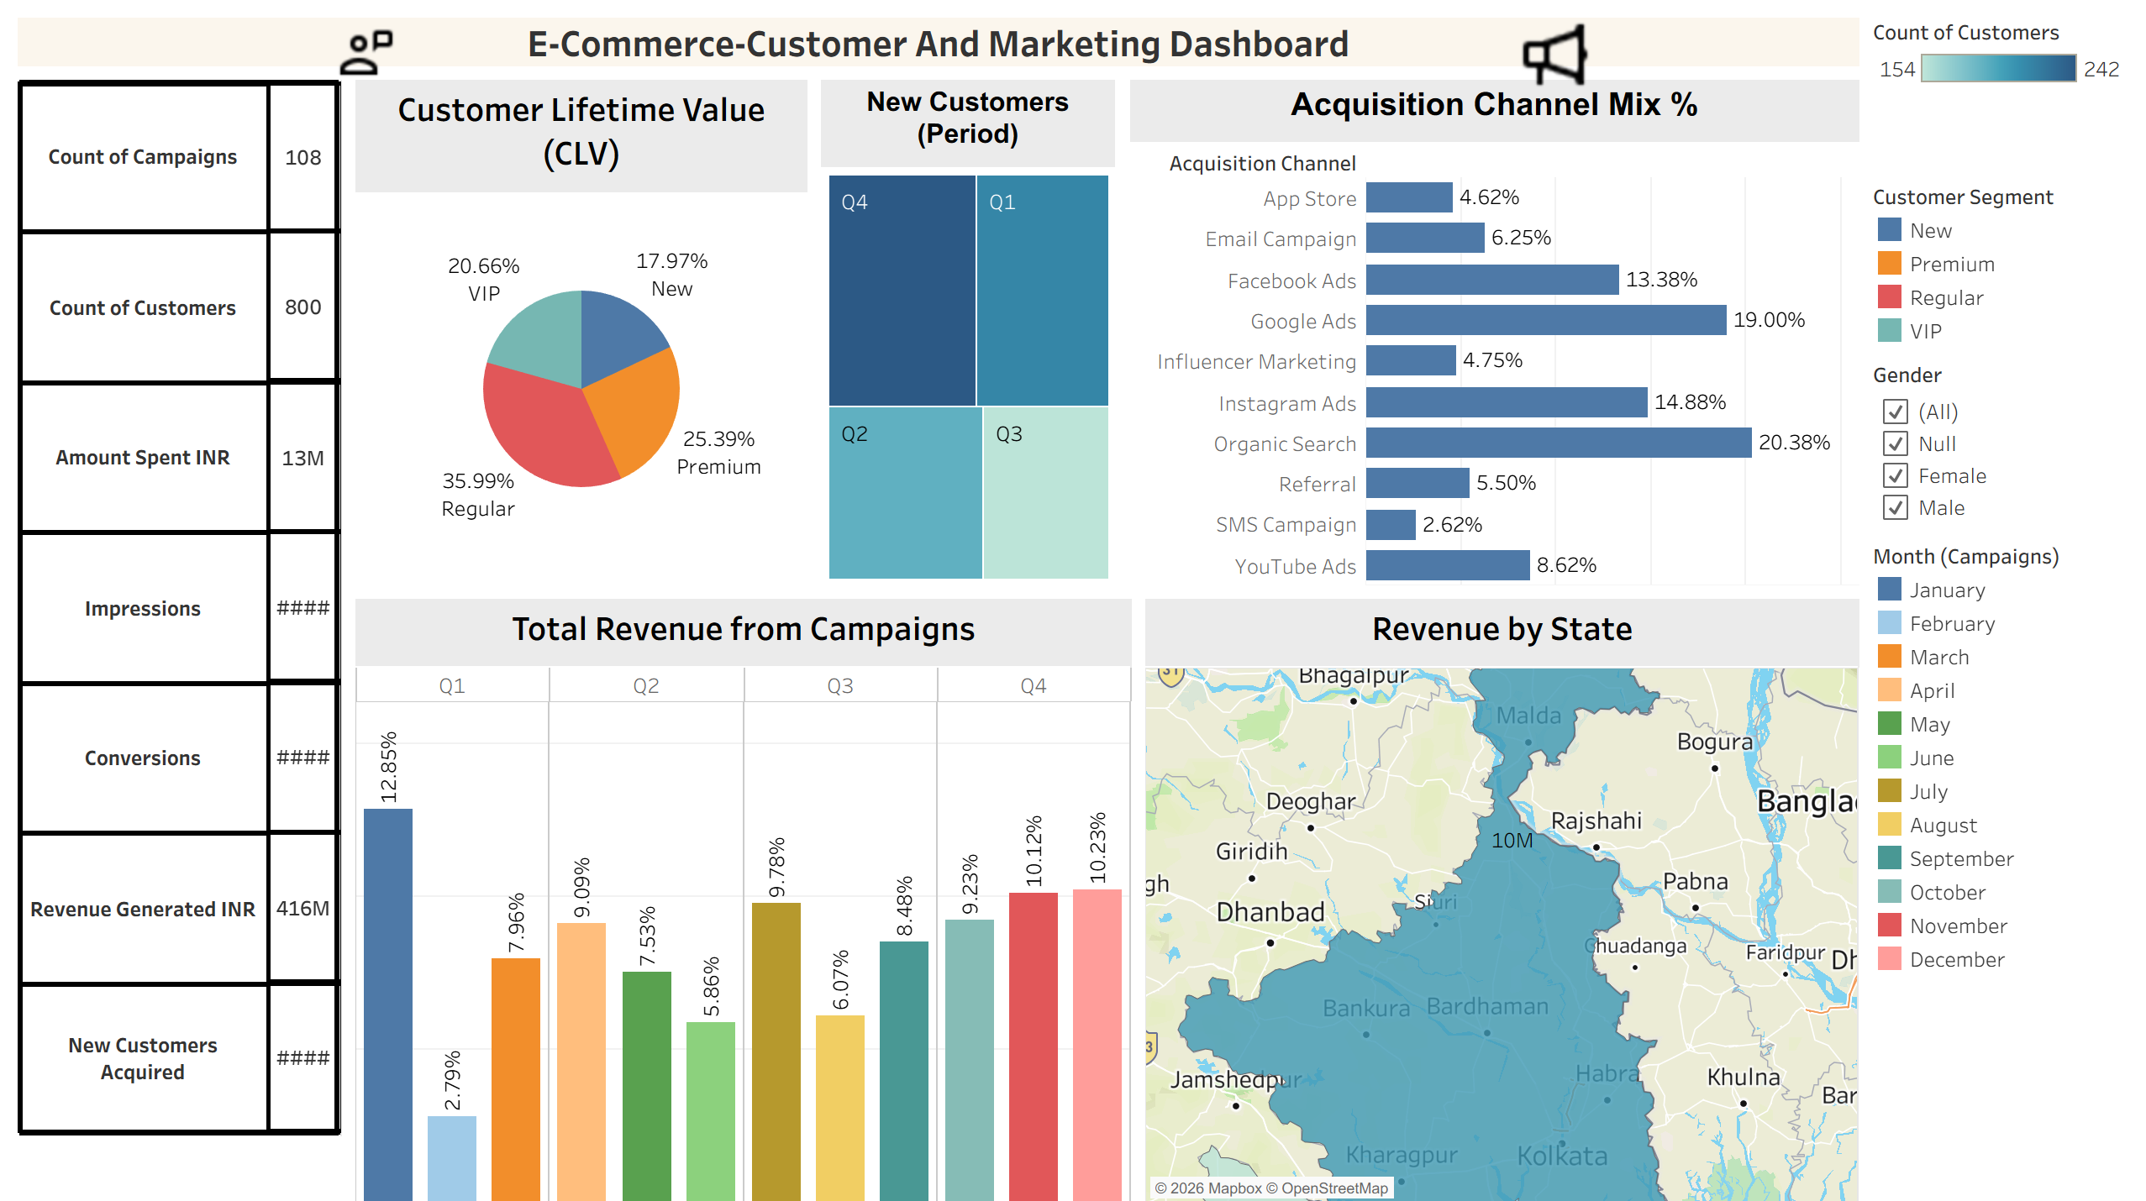
Tableau Dashboards
Dashboard 2 — Customer and Marketing Dashboard
ShopNova E-Commerce Analytics
12

Slide 13
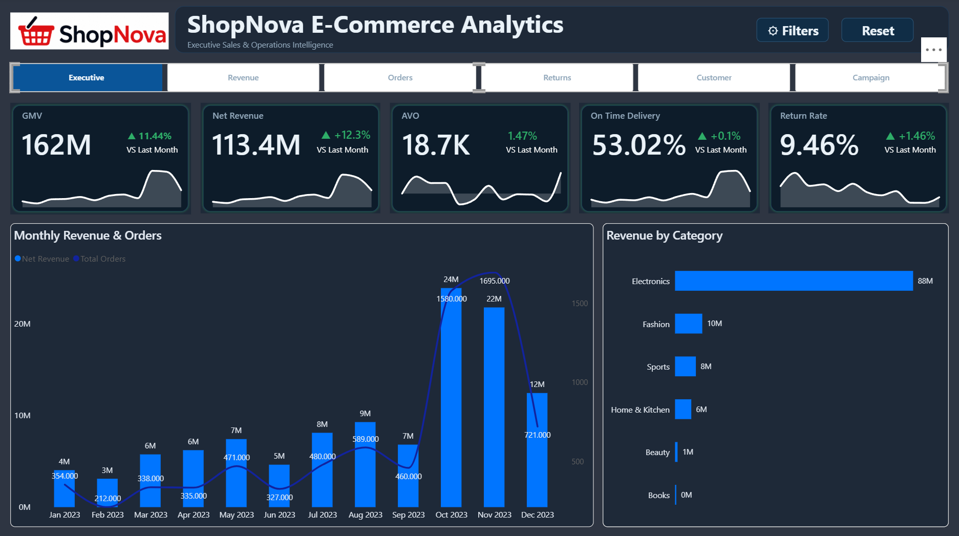
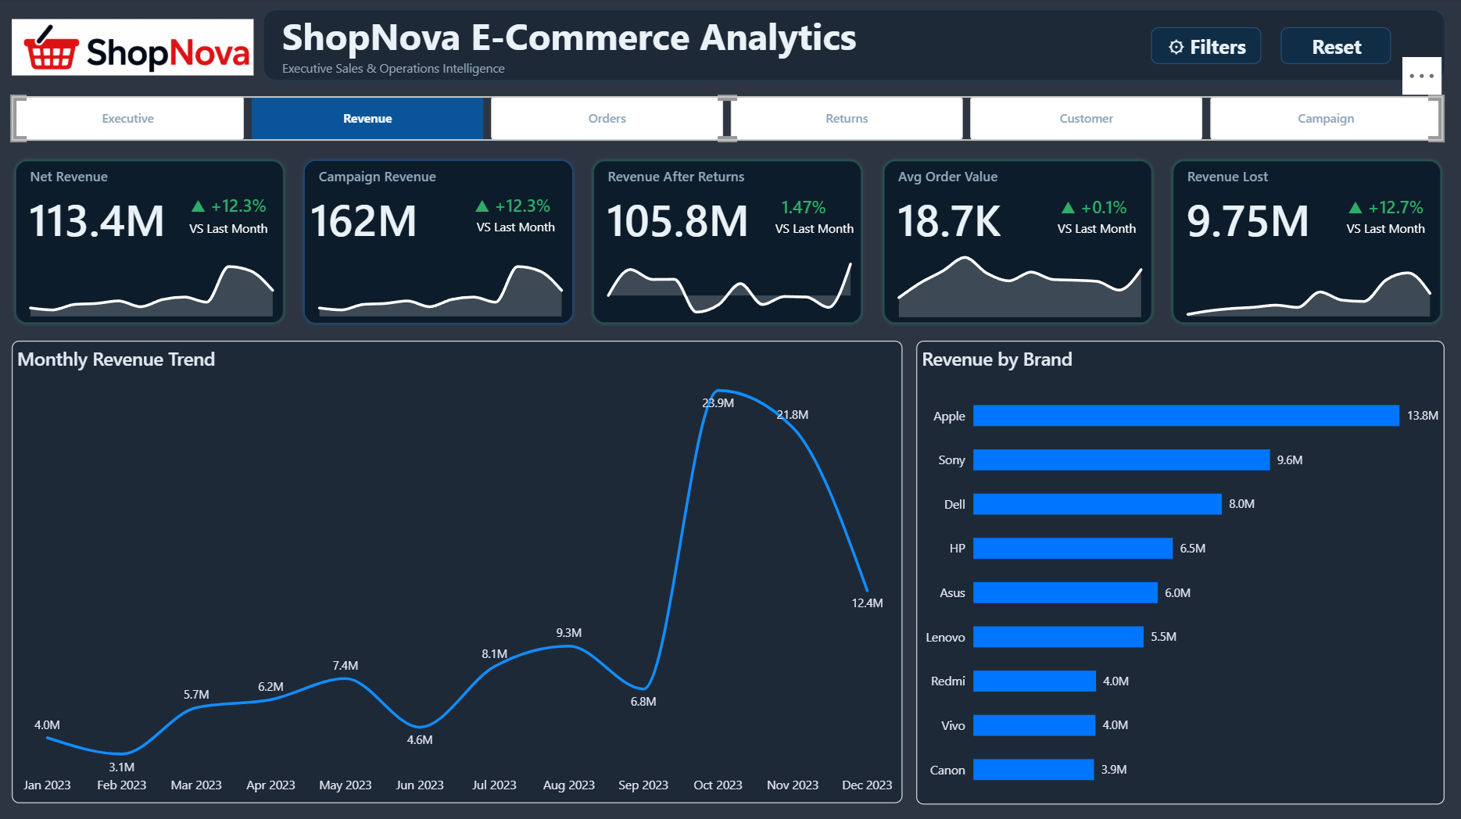
Power BI Dashboards
Executive Overview
Revenue Analysis
ShopNova E-Commerce Analytics
13

Slide 14
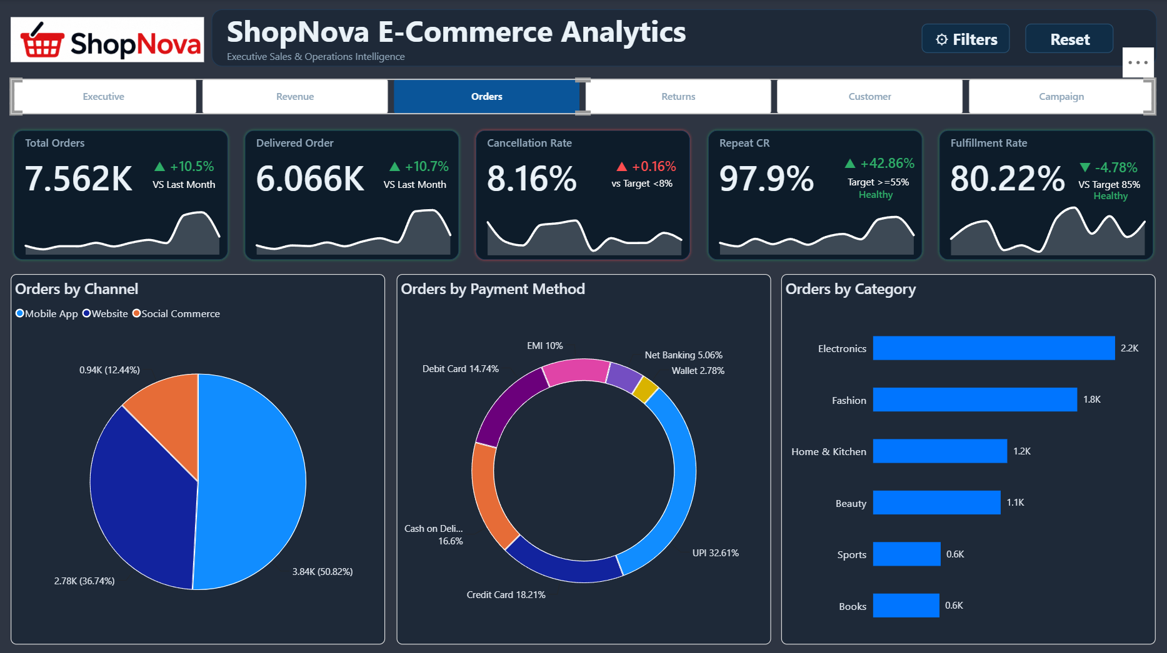
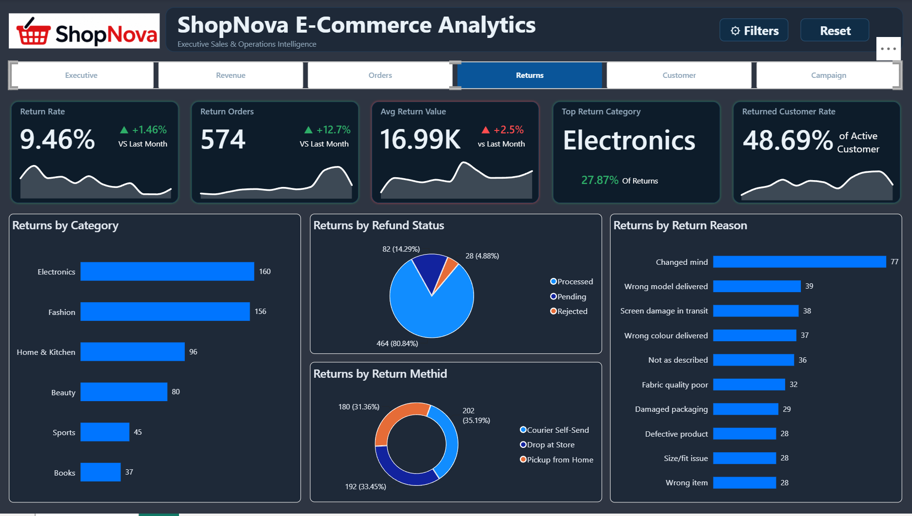
Power BI Dashboards
Orders Analysis
Returns Analysis
ShopNova E-Commerce Analytics
14

Slide 15
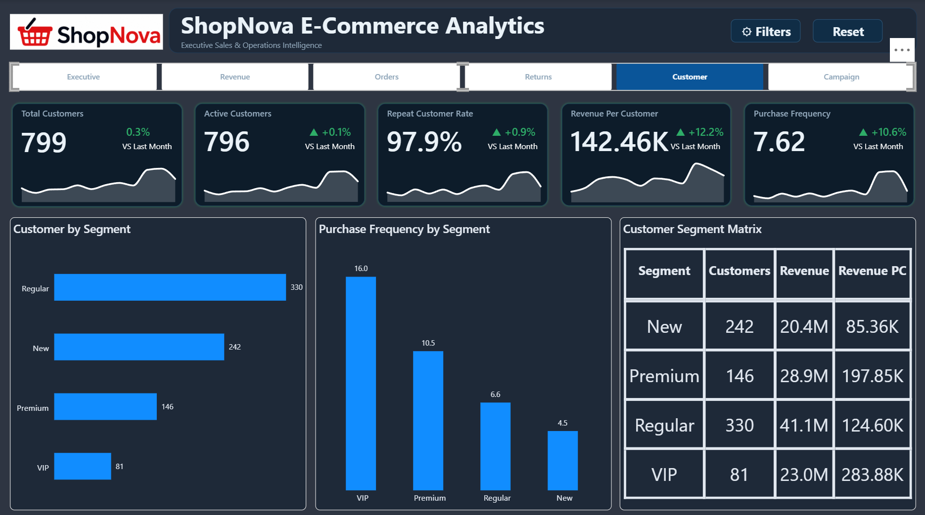
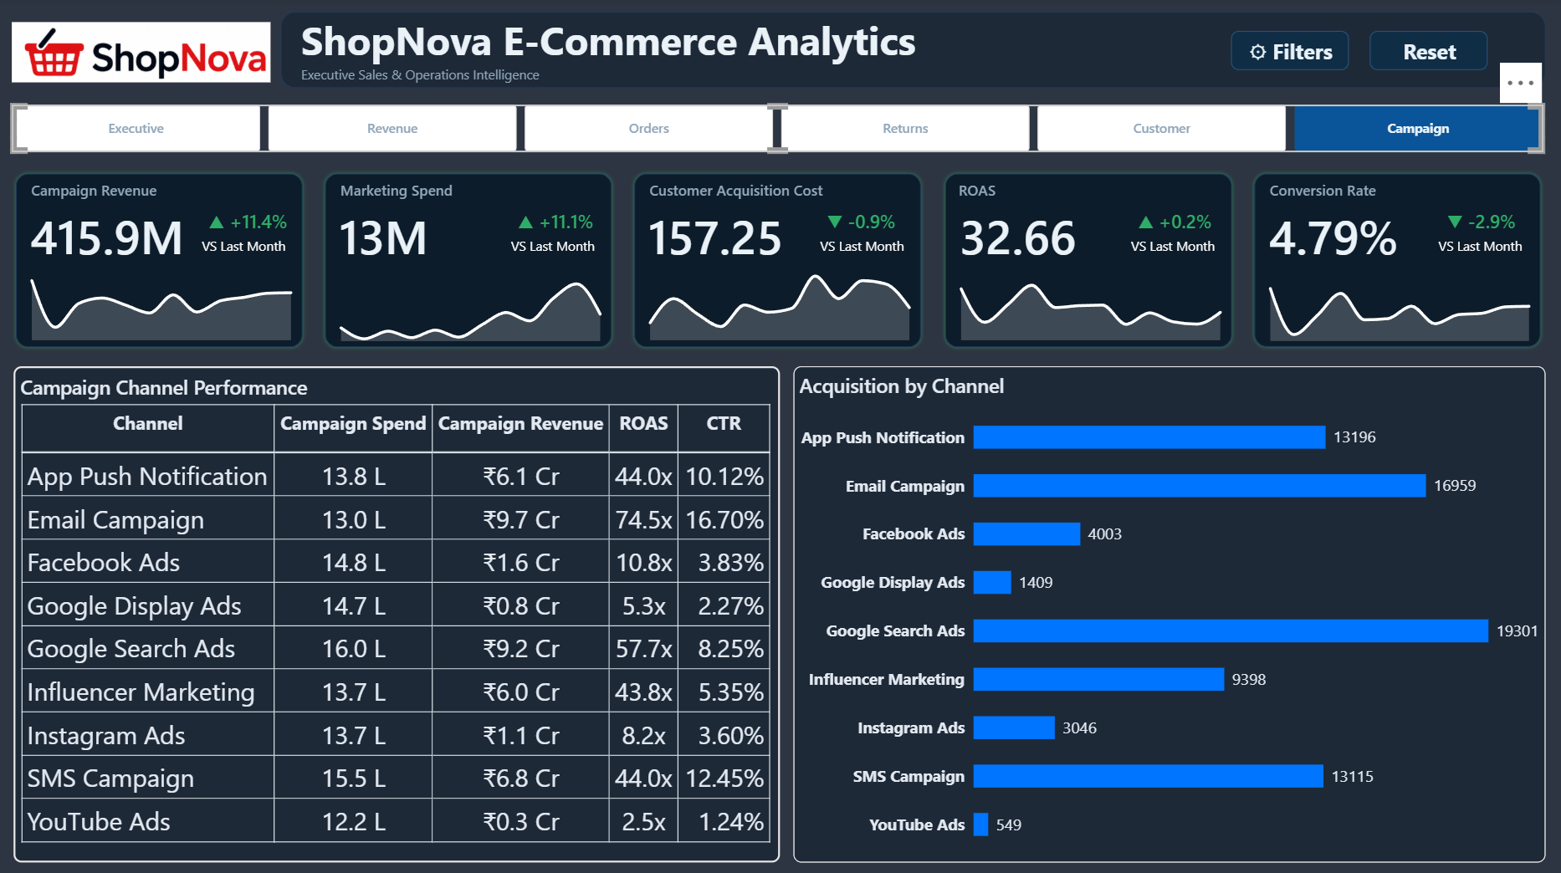
Power BI Dashboards
Customer Analysis
Campaign Analysis
ShopNova E-Commerce Analytics
15

Slide 16



KEY INSIGHTS
What the Data Tells Us
Electronics is the growth engine
77% of revenue sits in one category — concentration risk if demand dips
RECOMMENDATIONS
1
Diversify category mix — grow Fashion & Home to reduce reliance on Electronics
Loyalty pays off
Repeat customers (4,428 orders) already outnumber first-timers
2
Launch a loyalty/VIP programme to convert Regular customers into repeat buyers
Returns need attention
7.6% return rate, led by ‘changed mind’, with mixed post-return feedback
3
Investigate top return reasons at the product level to cut avoidable refunds
Marketing is efficient
Campaign spend converts into revenue at a strong overall ROAS
4
Reallocate budget toward channels with the highest ROAS and lowest CAC
ShopNova E-Commerce Analytics
16

Slide 17
Thank You
ShopNova E-Commerce Analytics Project · SQL · Excel · Tableau · Power BI

